Slide 1

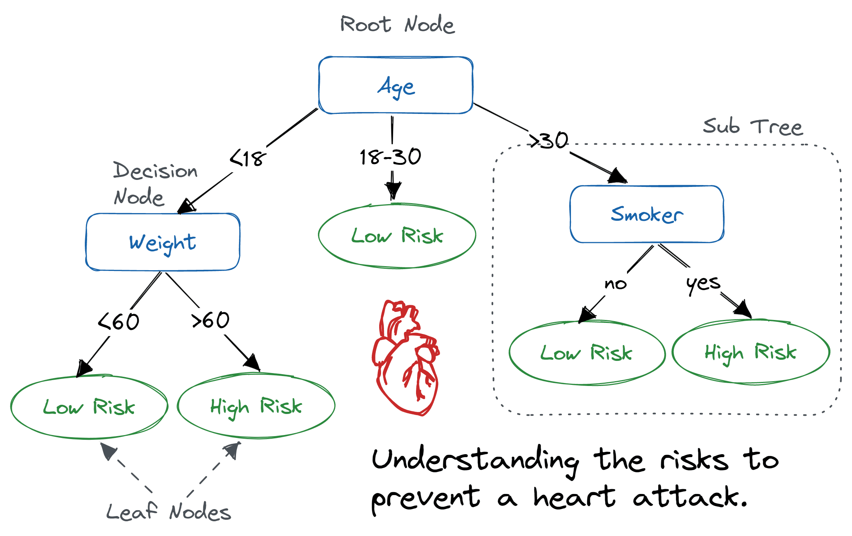
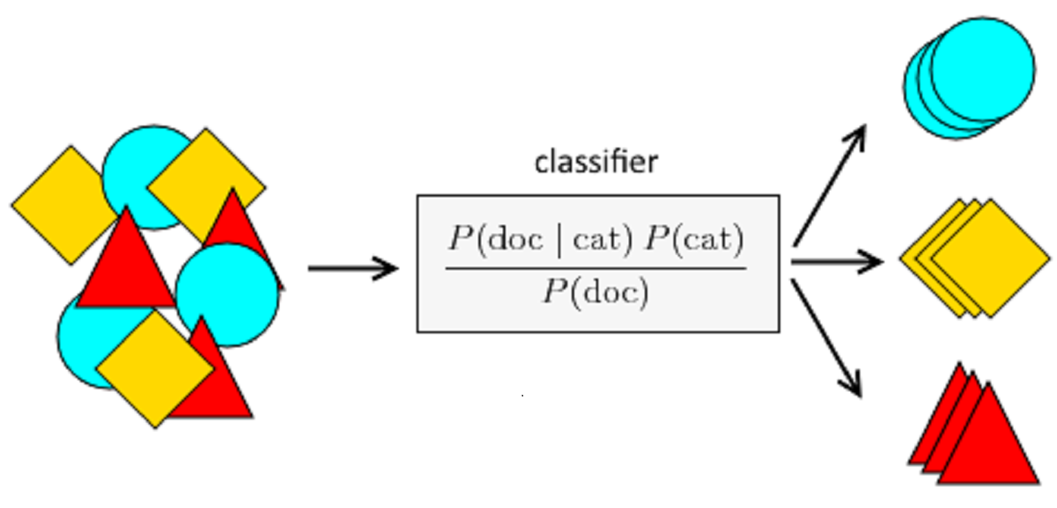
25-342
Anomaly Based Intrusion Detection for 5G Networks
Team members: Margarette Duckett, Kareem Aboulhosn, Michael Ott, Samuel Dominguez-Jacobo |
Faculty adviser: Milos Manic Ph.D. | Sponsor: Idaho National Labs | Mentor: Nick Kaminski Ph.D.
Decision tree
Results
Problem: Traditional IDS face challenges with zero-day attacks and high false-positive rates in dynamic network environments.
Solution: Our anomaly-based IDS leverages a hybrid approach combining Naive Bayes and Decision Trees to differentiate normal and malicious traffic based on unique underlying features. This method improves detection accuracy, reduces false positives, and scales efficiently for 5G data volumes. The system is designed to adapt to evolving threats, enhancing its capability to detect zero-day attacks and counter evasive techniques such as traffic encryption and obfuscation.
Usage: The Decision Tree is used to model decision rules based on feature values, splitting the data into smaller subsets based on feature thresholds.
Importance: It provides clear interpretability, helping understand how decisions are made (e.g., which features are most important for classification). It handles both categorical and numerical data well.
Best results for Naïve Bayes using CICIDS 2017 dataset
 | Naïve Bayes
Accuracy | .9644
Precision | .9665
Recall | .9644
Results
Best results for Decision Trees using CICIDS 2017 dataset
 | Decision Trees
Accuracy | .9946
Precision | .9917
Recall | .9809
ROC AUC | .9982
Naïve Bayes
Usage: Naive Bayes is a probabilistic classifier based on Bayes' Theorem, assuming feature independence. It is typically used for fast, simple classification tasks.
Importance: It’s fast, requires fewer resources, and works well with high-dimensional data, making it useful when data has many features or for real-time prediction.
References
[1]Wang, Z., & Su, X. (2019). Anomaly detection based on deep learning: A survey. Complex & Intelligent Systems, 5(4), 1-26. https://doi.org/10.1186/s42400-019-0038-7
[2]Sharma, N., & Suryakanthi, V. (2013). Anomaly based network intrusion detection: A review. 2013 International Conference on Advances in Computing, Communications and Informatics (ICACCI), 2013, 1374-1379. https://doi.org/10.1109/ICACCI.2013.6637431

